Slide 1
Rockbuster Stealth
Data Analysis Project
Ilda Muca

Slide 2
Summary
Top countries and cities that Rockbuster customer are based
Customer with high lifetime based
Movies that contribute to gain the revenue:
Most popular movie title
Most popular genre
Most popular rating

Slide 3
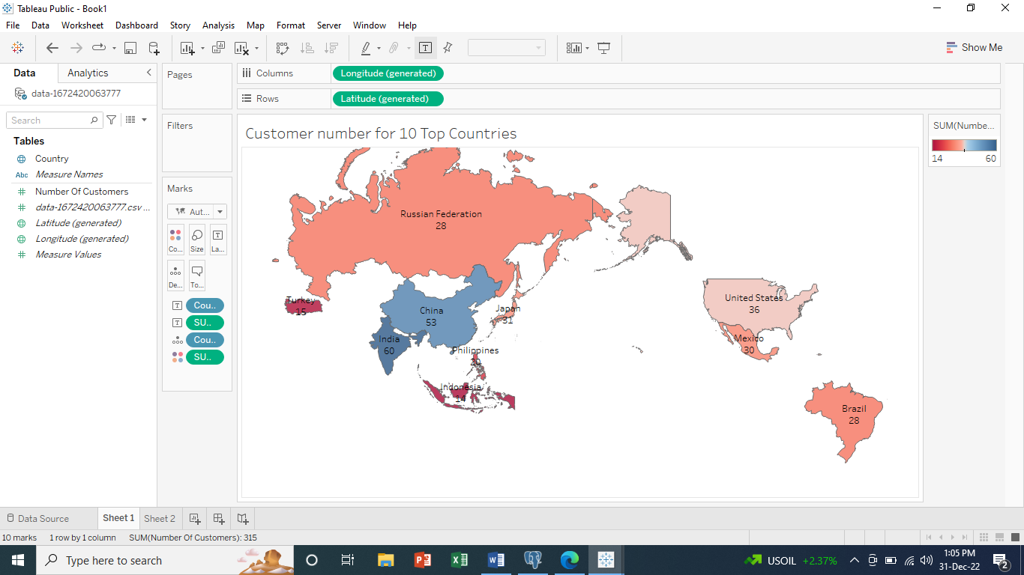
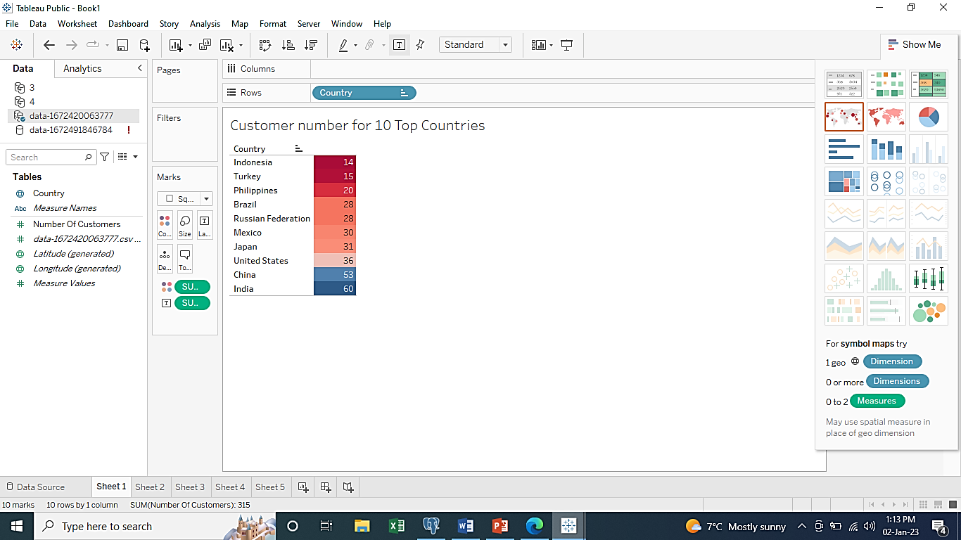
Customer number for 10 Top Countries

Slide 4
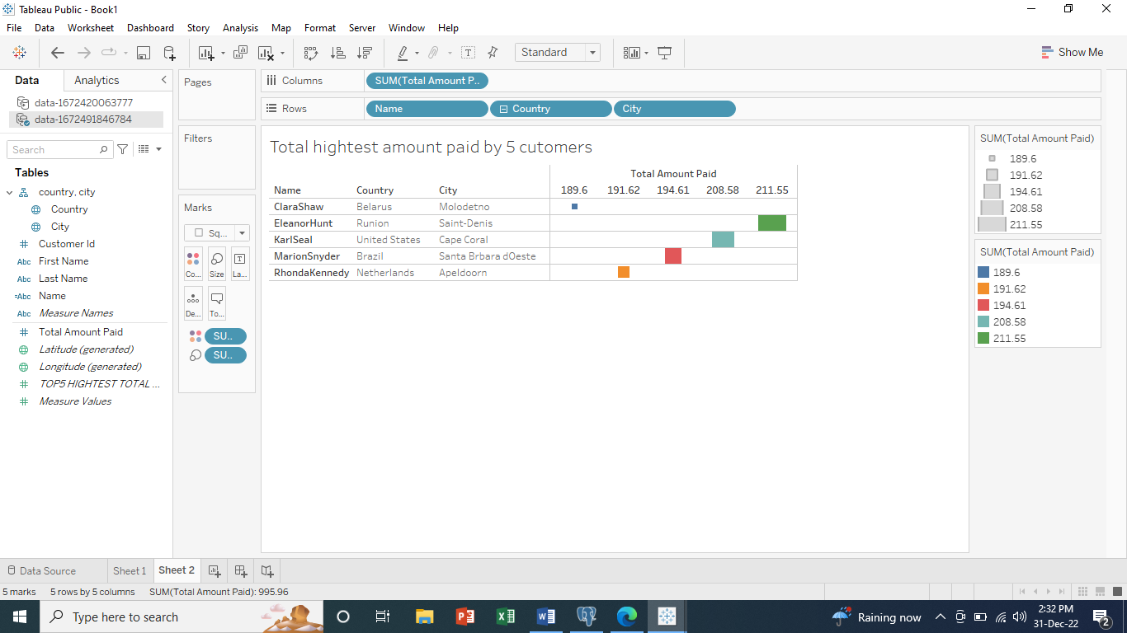

Slide 5
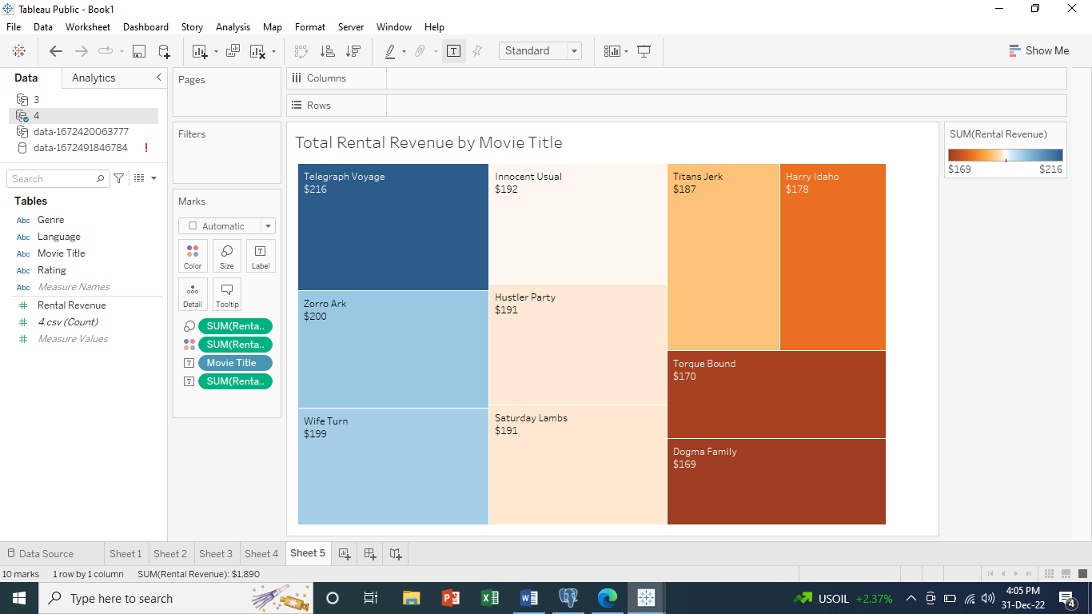
Rental Revenue for 10 most rented movies
Total Revenue from ALL MOVIE RENTALS:
$ 61312.04

Slide 6
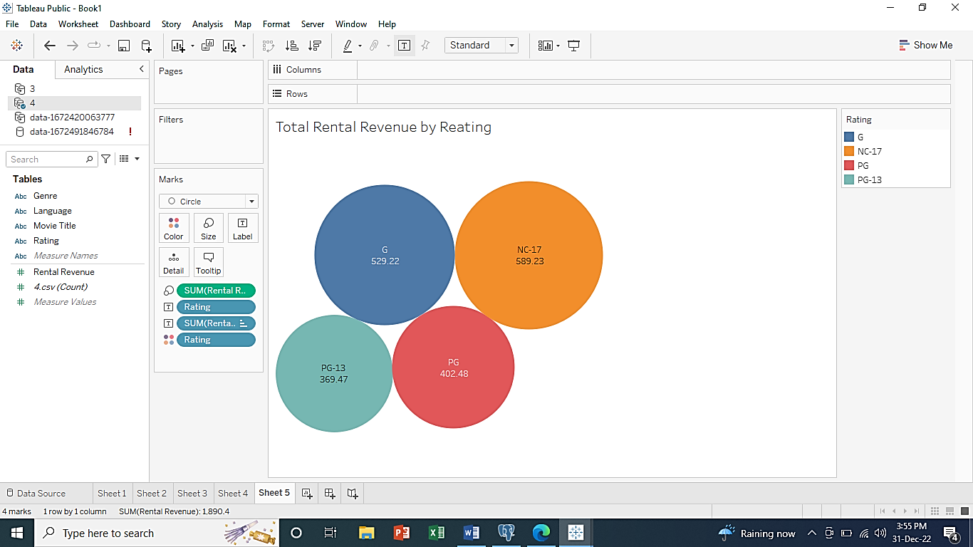
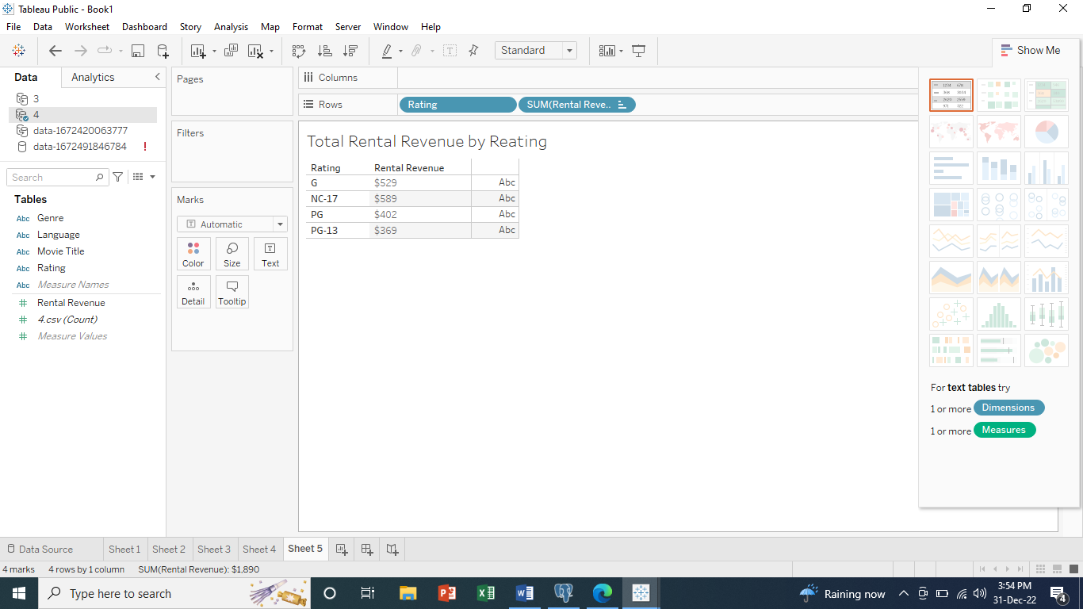

Slide 7
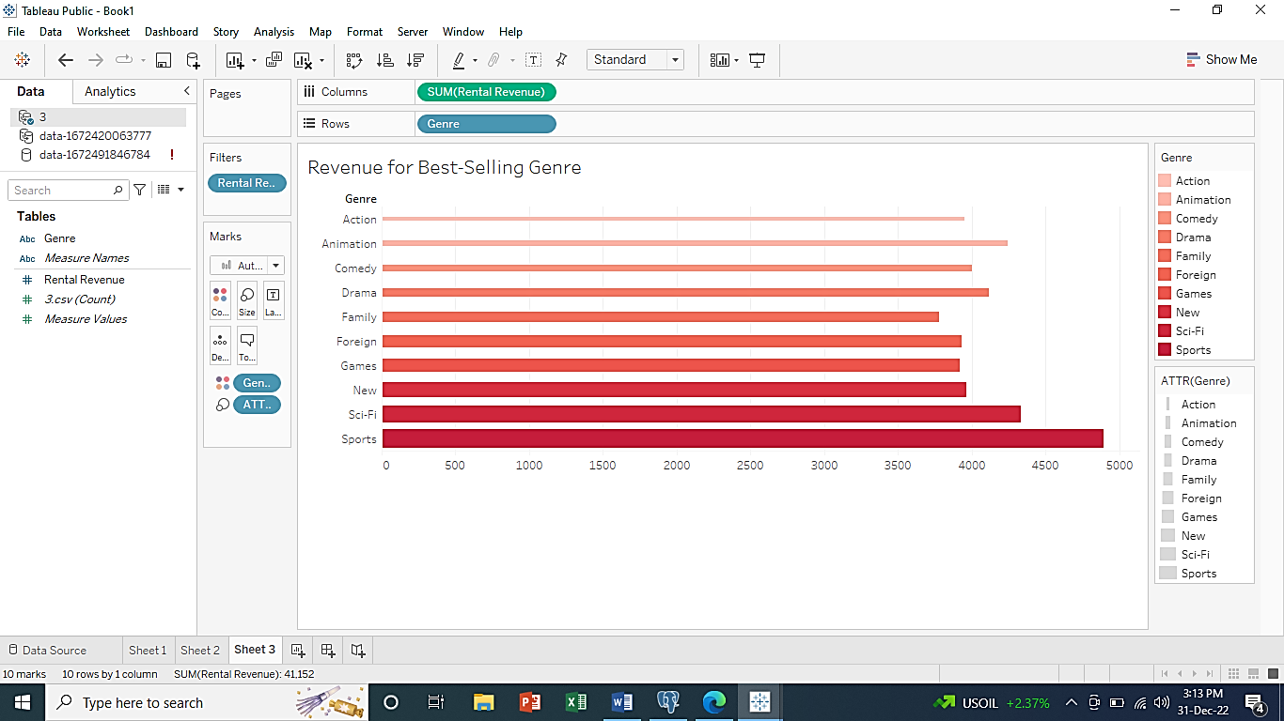
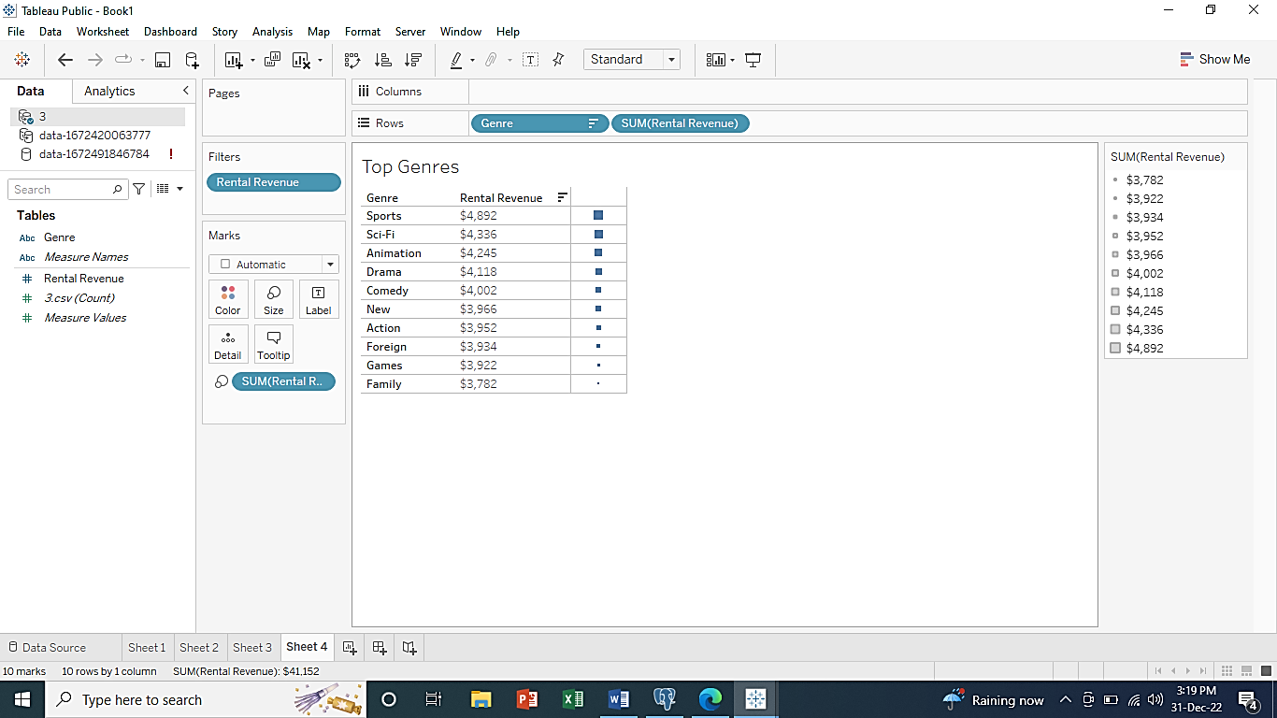
Top Genres and Revenue

Slide 8
Project Summary
What countries are Rockbuster customers based in ?
There is a total of 599 Rockbuster costumers allocated all around the world.
Rockbuster Customers are based mostly in India (60), China(53), United States (36).
The countries with the most customers are also the one that generates most revenue from movie rentals.

Slide 9
Project Summary
Which movies contributed the most to revenue gain?
Top 3 movie title that that bring the most revenue:
The Teleghaph Voyage,
Zorro Ark
Wife Turn
Total Revenue from ALL MOVIE RENTALS is $ 61312.04
The Leading Genre are: Sports, Sci-Fi, Animation & Drama.

Slide 10
Recommendations
The data tells that profit is higher in countries where Rockbuster has a larger customer based.--- I would recommend Rockbuster prioritize launching rental services in top 10 countries with most customers.
Invest more in China and India since they have largest number of customers.
Organize Giveaway for customers that spend over $100.

Slide 11
Questions:
Please contact me :
Dail.1996@outlook.com

